Slide 1
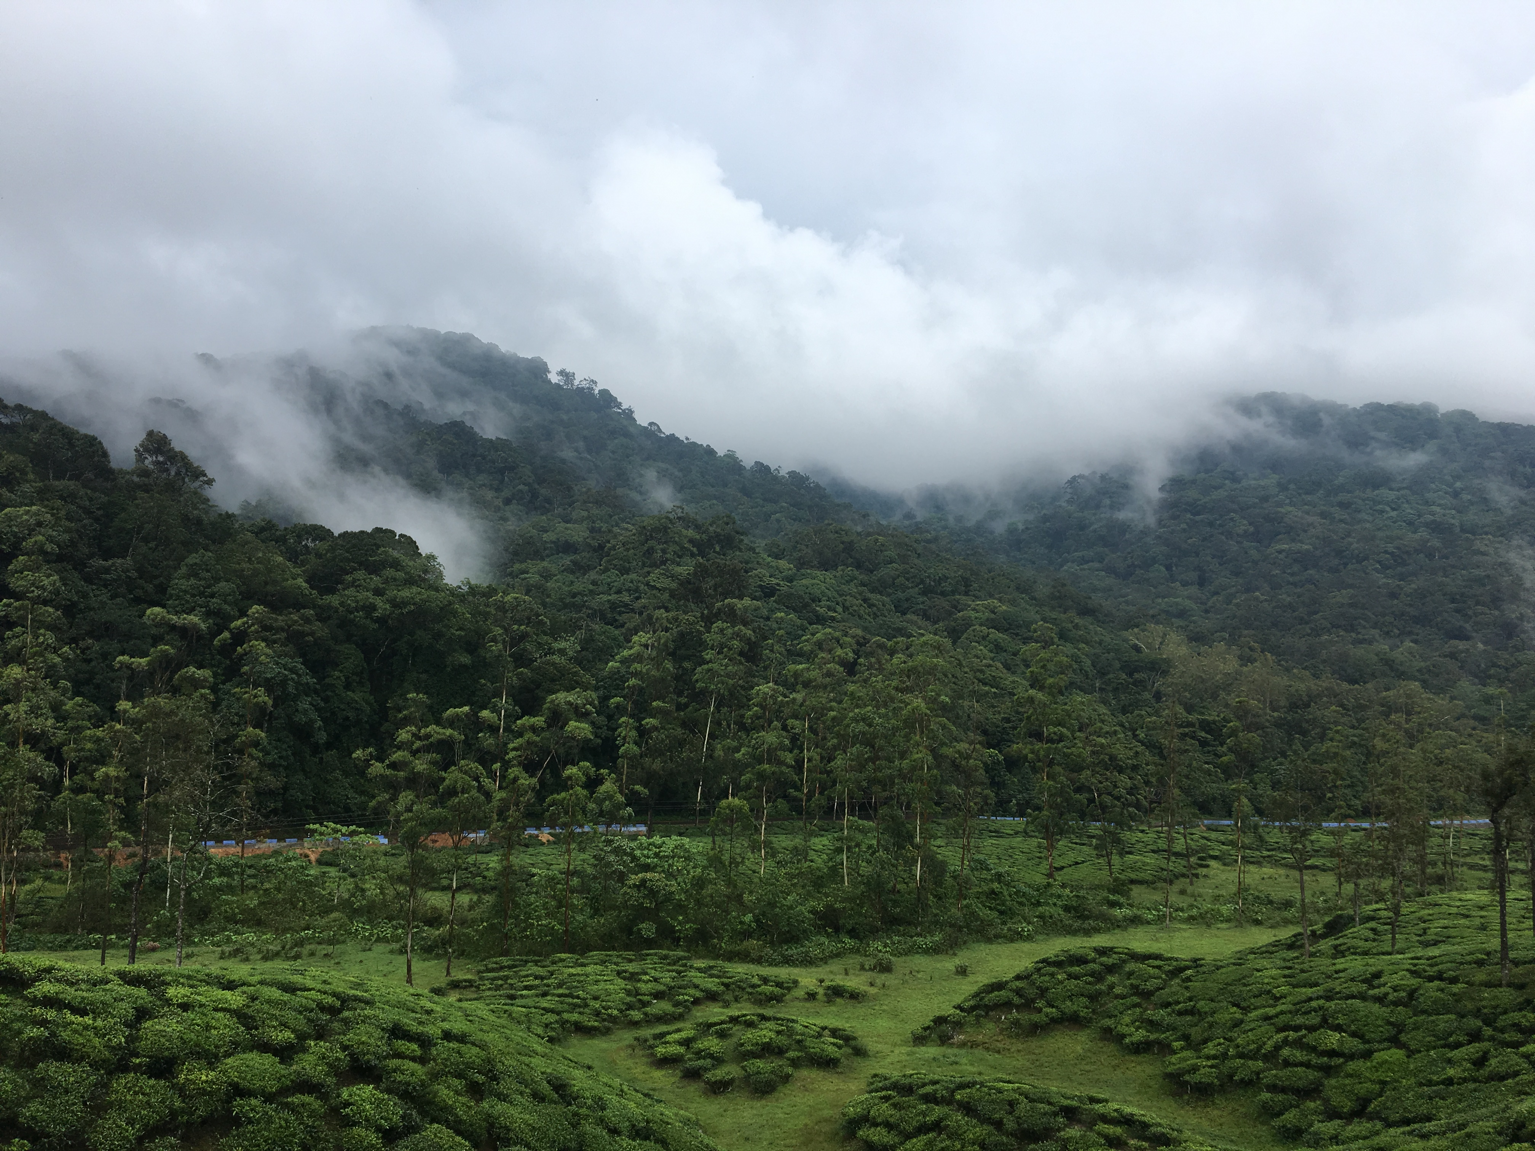



Reproducible scientific practices for conservation biologists
Vijay Ramesh
Postdoctoral Fellow
vjjan91

Slide 2
01
What is reproducibility?
02
Data & code reproducibility
Today’s Agenda
03
Git & version control
04
Hands on: GitHub + R

Slide 3
01
What is reproducibility?
02
Data & code reproducibility
Today’s Agenda
03
Git & version control
04
Hands on: GitHub + R

Slide 4
What is reproducibility?
Research is “reproducible when others can reproduce/replicate the results of a study given only the original data, code, and documentation”
Replication is the gold standard for scientific rigor
Misconception: I need to worry about this only after my data collection is complete
Essawy et al. 2020, Environmental Modelling & Software; Alston and Rick 2021, Ecological Society of America

Slide 5




Why should I care about reproducibility?
Collaborative research
Publication mandates
Testing your methods
Increase efficiency & transparency
Minimize data loss/reduce risk
Who benefits?
YOU BENEFIT IF YOU MANAGE YOUR DATA WELL!
BES Guide to Data Reproducibility

Slide 6
Three key steps for reproducibility
Data storage and organization
Best coding and file naming practices
Finalizing results and sharing
Alston and Rick 2021, Ecological Society of America

Slide 7
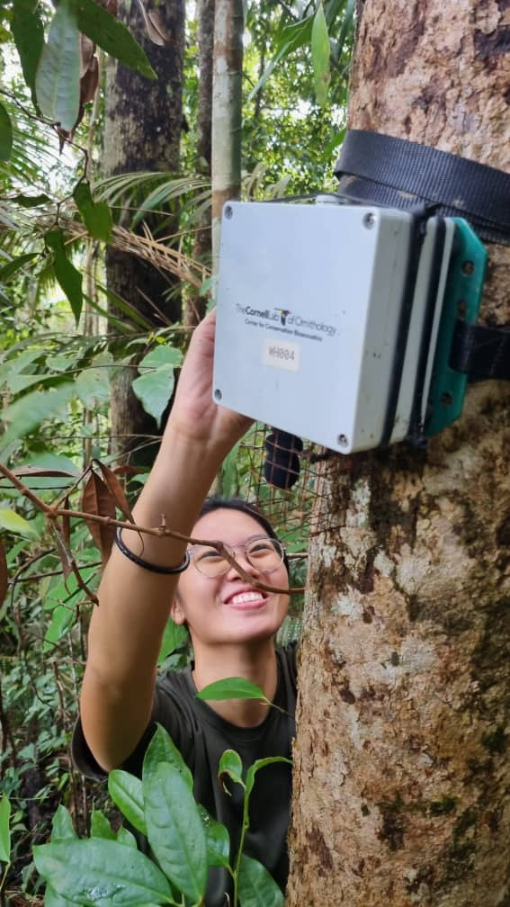
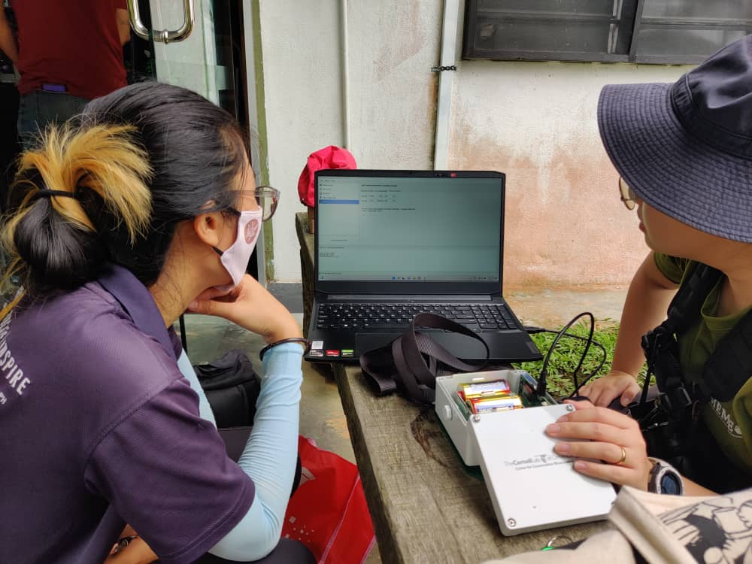

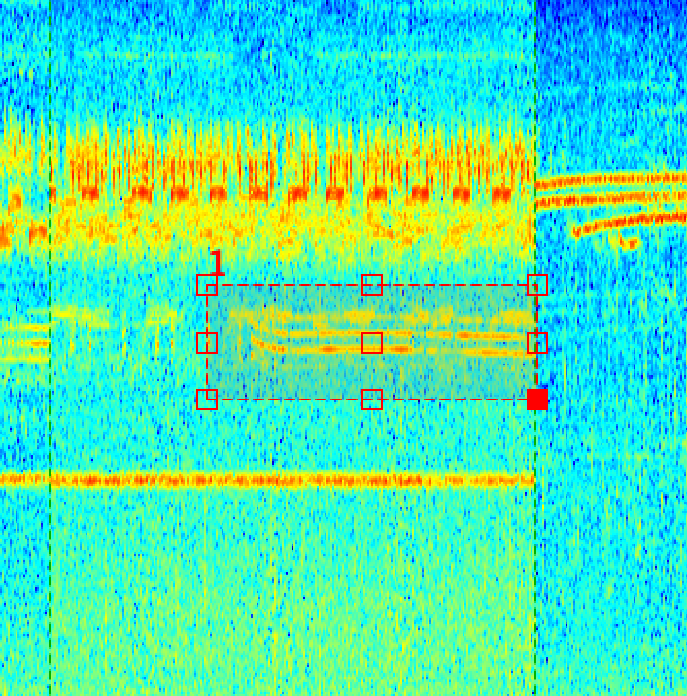
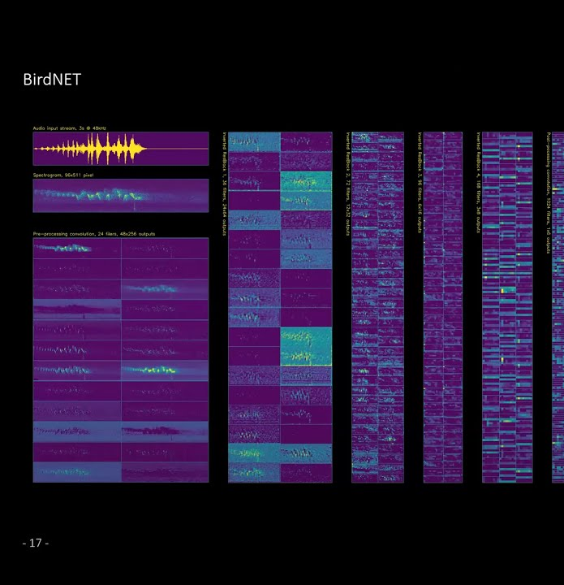
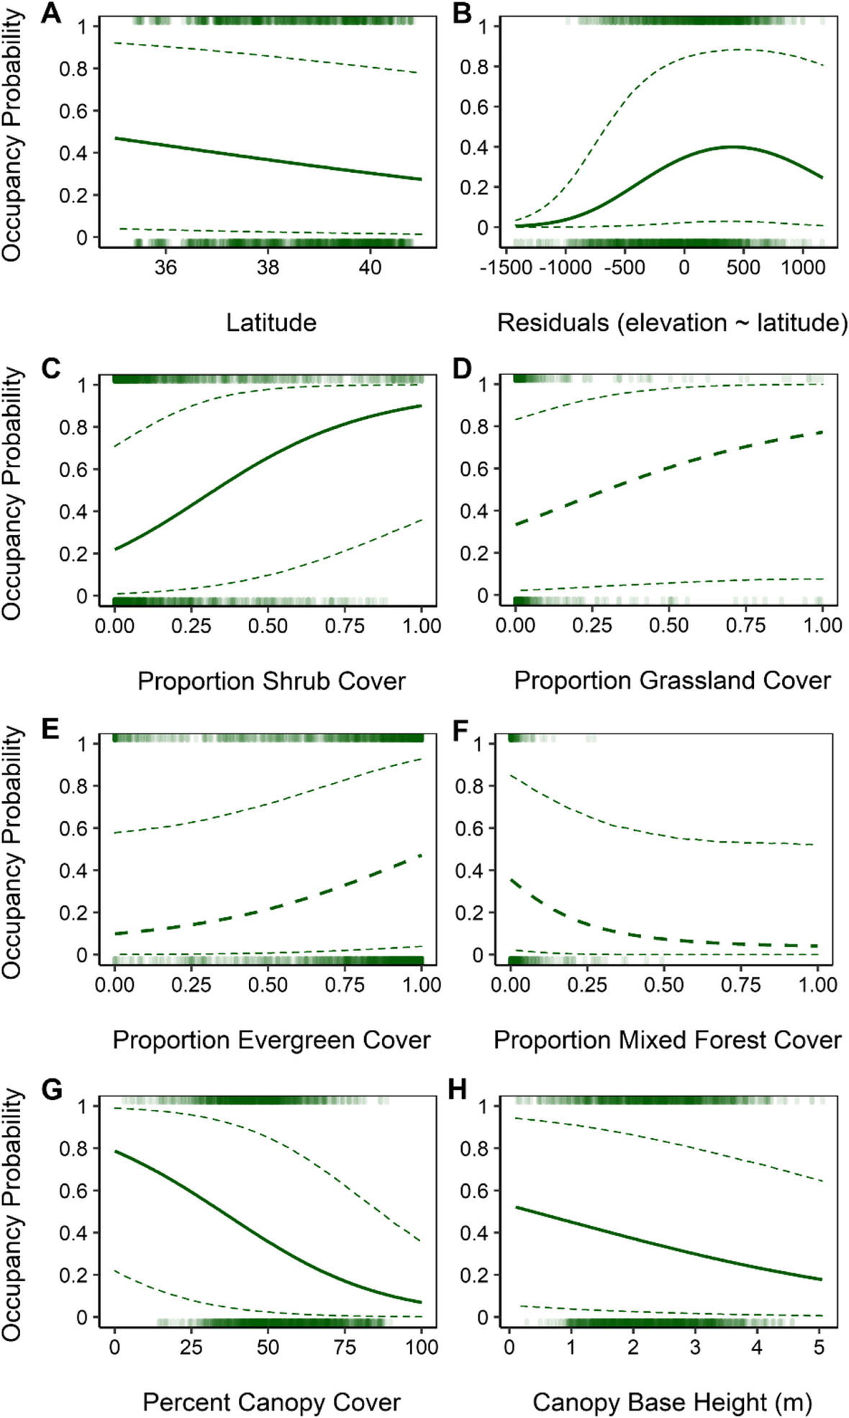
Steps in a scientific study
2
3
1
Data Collection
Data Management
4
Research Question and Study Design
6
5
Manual Analysis
Ecological Insights
Automate Analysis

Slide 8
01
What is reproducibility?
02
Data & code reproducibility
Today’s Agenda
03
Git & version control
04
Hands on: GitHub + R

Slide 9
What sorts of data do scientists work with?
Observational
Metadata
Experimental
Derived
Simulated
Your data lives longer than your project!
BES Guide to Data Reproducibility

Slide 10
What we don’t think about before we start a project..
What data will I generate?
How will I store my data?
Did I make two copies?
Are they backed up regularly?
How will I organize my data?
Are my folders self explanatory?
Did I use standardized variable names?
What data formats should I use?
Do I have metadata to explain my data and analysis?

Slide 11


Data organization structure
Basic format
├── data/
├── manuscript/
├── results/
├── figures/
└── scripts/
Example 1
├── data/
│ ├── processed/
│ └── raw/
├── manuscript/
├── output/
│ └── figures/
│ ├── exploratory/
│ └── final/
└── scripts/
Example 2
├── analyses/
├── data/
├── data-raw/
├── docs/
├── inst/
├── man/
├── manuscript/
├── R/
└── tests/
Example 3
├── data/
├── data-raw/
├── docs/
├── experiments/
├── man/
├── manuscripts/
├── model/
├── posters/
├── R/
├── slides/
└── vignettes/

Slide 12
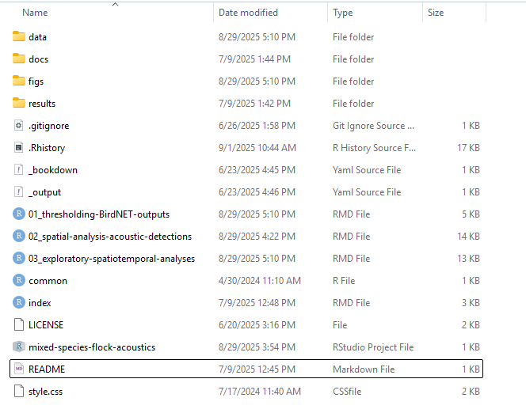
My structure
data
results
figures
README
docs
code

Slide 13
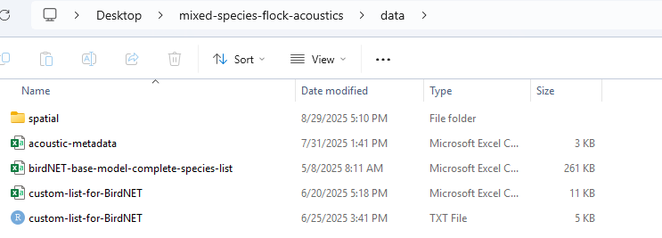
Provide content appropriate names

Slide 14
Naming conventions of files and folders
Avoid spaces between names
spatial data vs. spatial-data
Hyphenate folder names or file names
Provide content appropriate names
Lowercase letters are preferred
For scripts, use numbers to illustrate chronological sequence
01_exploratory-data-analysis.Rmd
02_glmer-abundance-vs-acoustic-detections.Rmd
Numbers are also useful to illustrate versions
avian-traits-ver01.csv
avian-traits-ver02.csv
But…version control solves the above problem

Slide 15
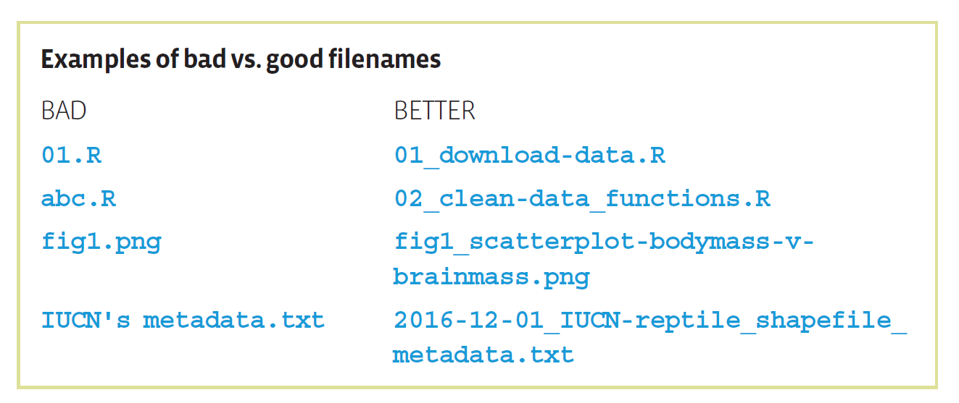
Best practices for a reproducible project
BES Guide to Data Reproducibility

Slide 16

Within file data organization (example: a .csv file)
Store data in a tidy format
variables are in columns and observations in rows
No spaces in variable names
Why? Easy to code and reduces errors
Use underscores where needed and reduce capitalizations (if possible)*
Aru sampling time vs. aru_sampling_time
camelCase vs snake-case
siteName vs site_name
Keep the structure within a column consistent*
Numbers only or text only or alphanumeric only
We won’t go into detail about how you manage your data – happy to chat separately

Slide 17
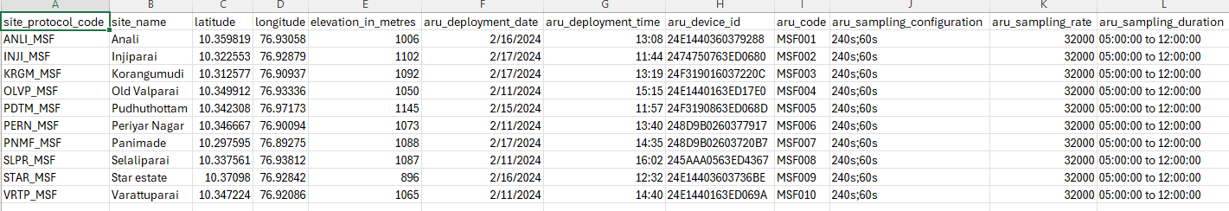
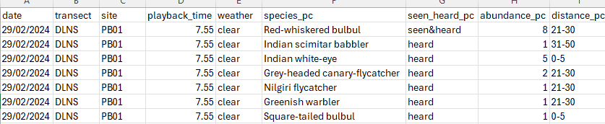
Examples

Slide 18
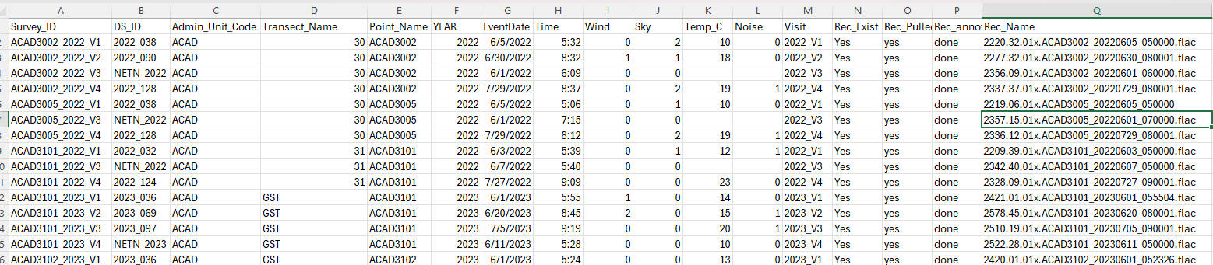

Why is this not the best way to organize your file?

Slide 19
Let’s talk metadata
All your files are organized
All your data is organized
Metadata is key to reproducibility
Notes:
But is there a quick guide for you (8 months later) or anyone else to understand your data, and code structure?

Slide 20
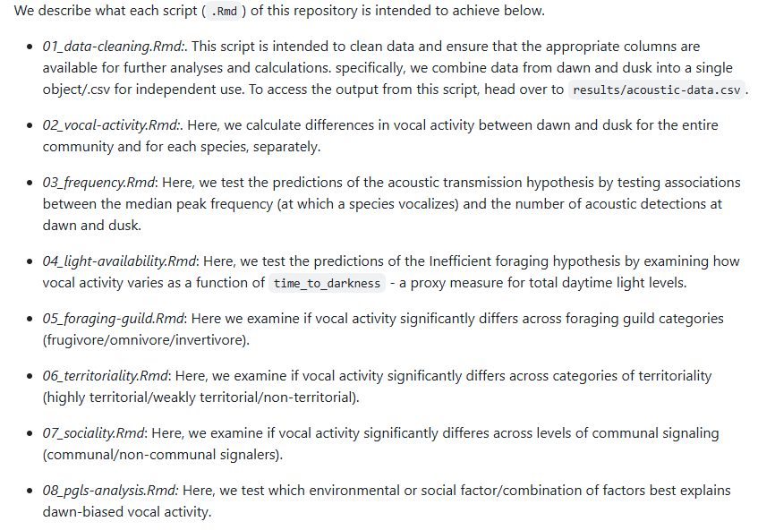
README examples

Slide 21
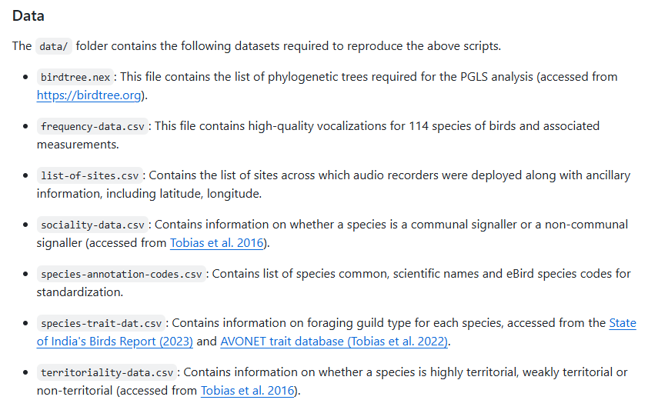

Slide 22
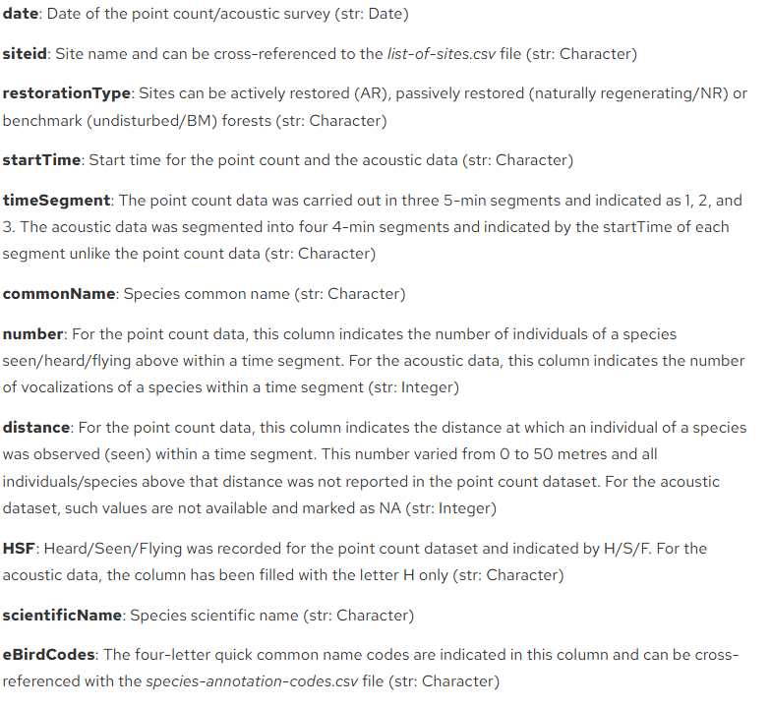
Metadata for certain files

Slide 23
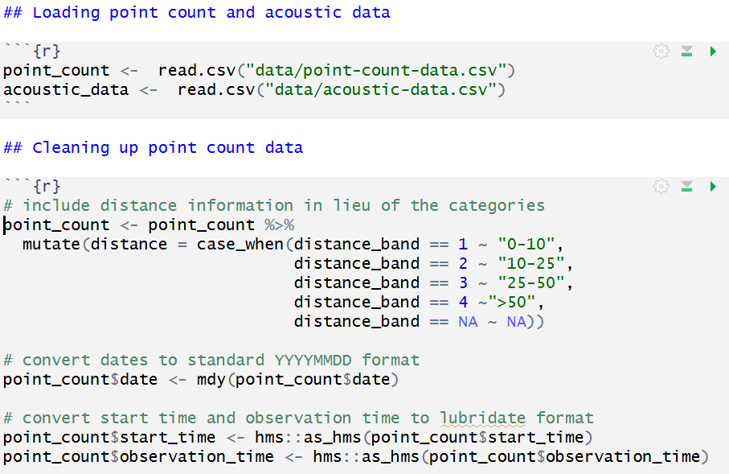

Code reproducibility
Document what you do!
Annotate, annotate, annotate
Easy to use object names
Use styling packages for clean code
Version control and GitHub for documenting changes

Slide 24
01
What is reproducibility?
02
Data & code reproducibility
Today’s Agenda
03
Git & version control
04
Hands on: GitHub + R

Slide 25

Version control
keep the entire history of a file
tag particular version so you can go back to them easily
facilitates collaborations and makes contributions transparent
experiment with code and feature without breaking the main project

Slide 26
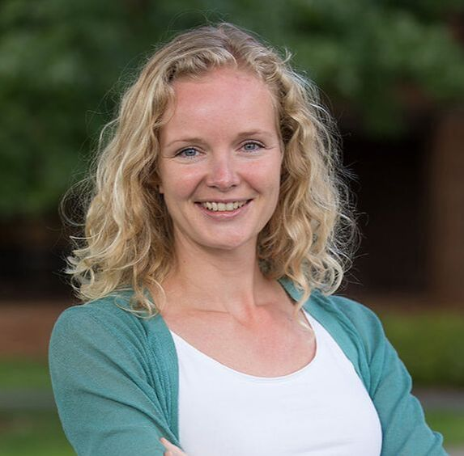
What is Git and GitHub?
Git is a program that you install on your computer: it is a version control software that tracks changes to your files over time
GitHub is a website for code and data – not only an archive, but you can interact with other people’s files and data
Lots of cool features: visualize differences between images, rendering & diffing map data files, render text data files, and track changes in text and more!
Dr. Nina Therkildsen, Cornell University
https://nt246.github.io/NTRES-6100-data-science/index.html

Slide 27
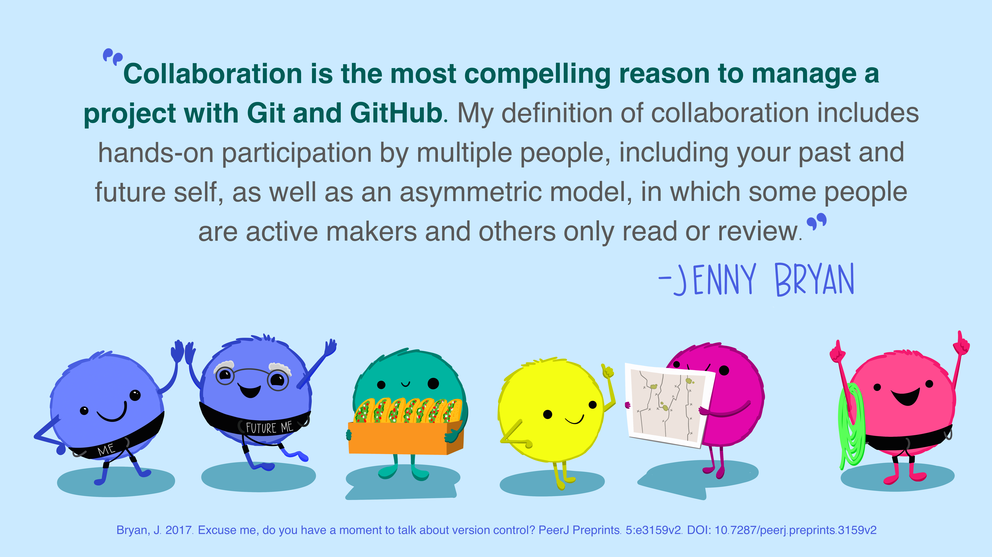
Source: Openscapes.org

Slide 28
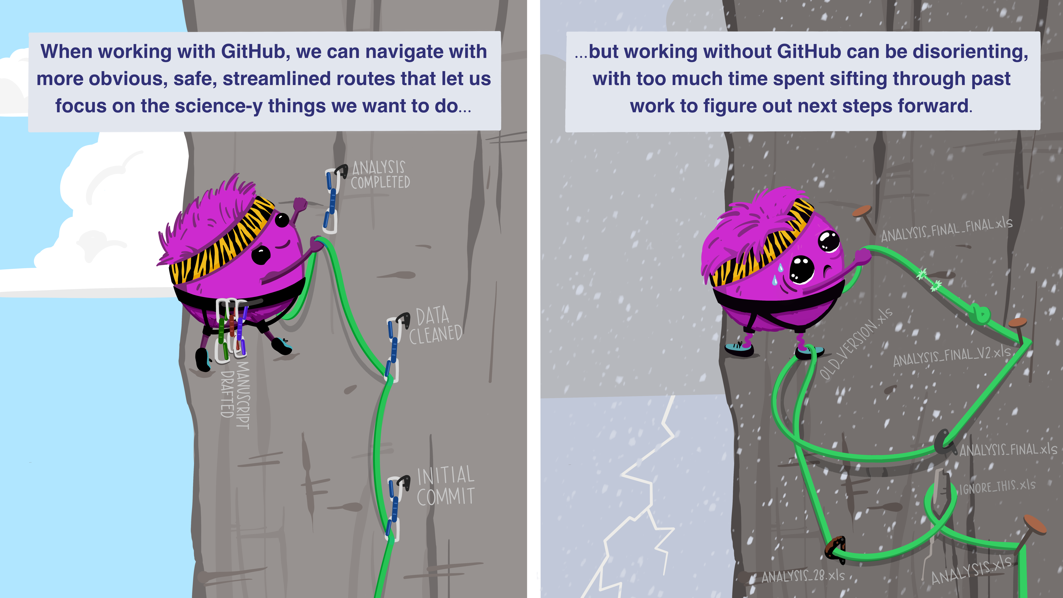
Streamlining your work!
Source: Openscapes.org

Slide 29
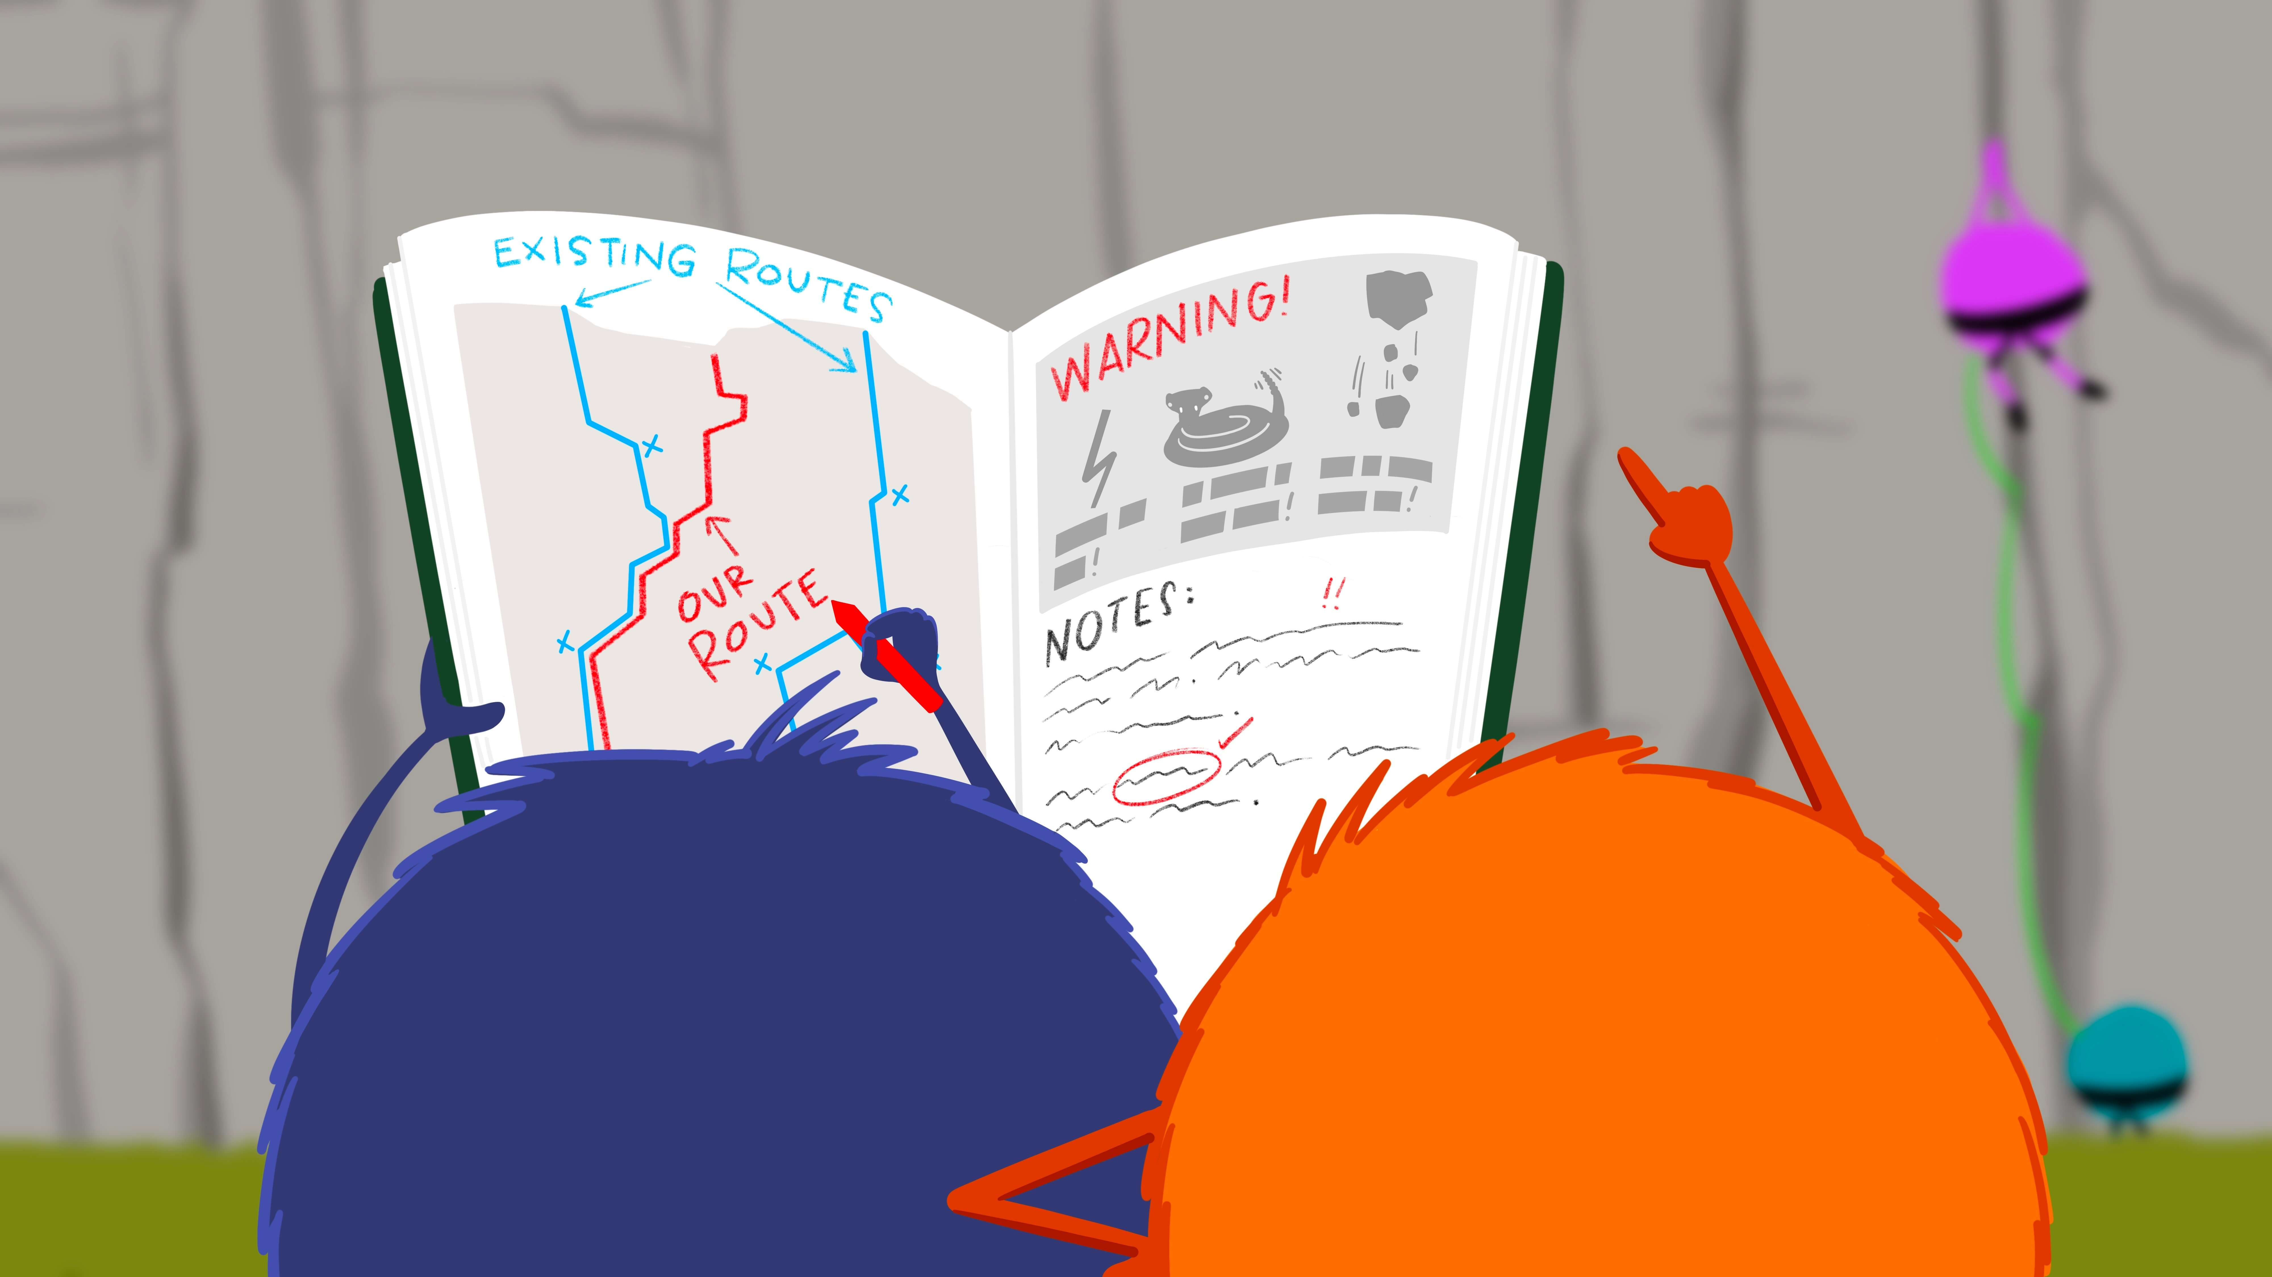
Safely reuse and collaborate!
Source: Openscapes.org

Slide 30
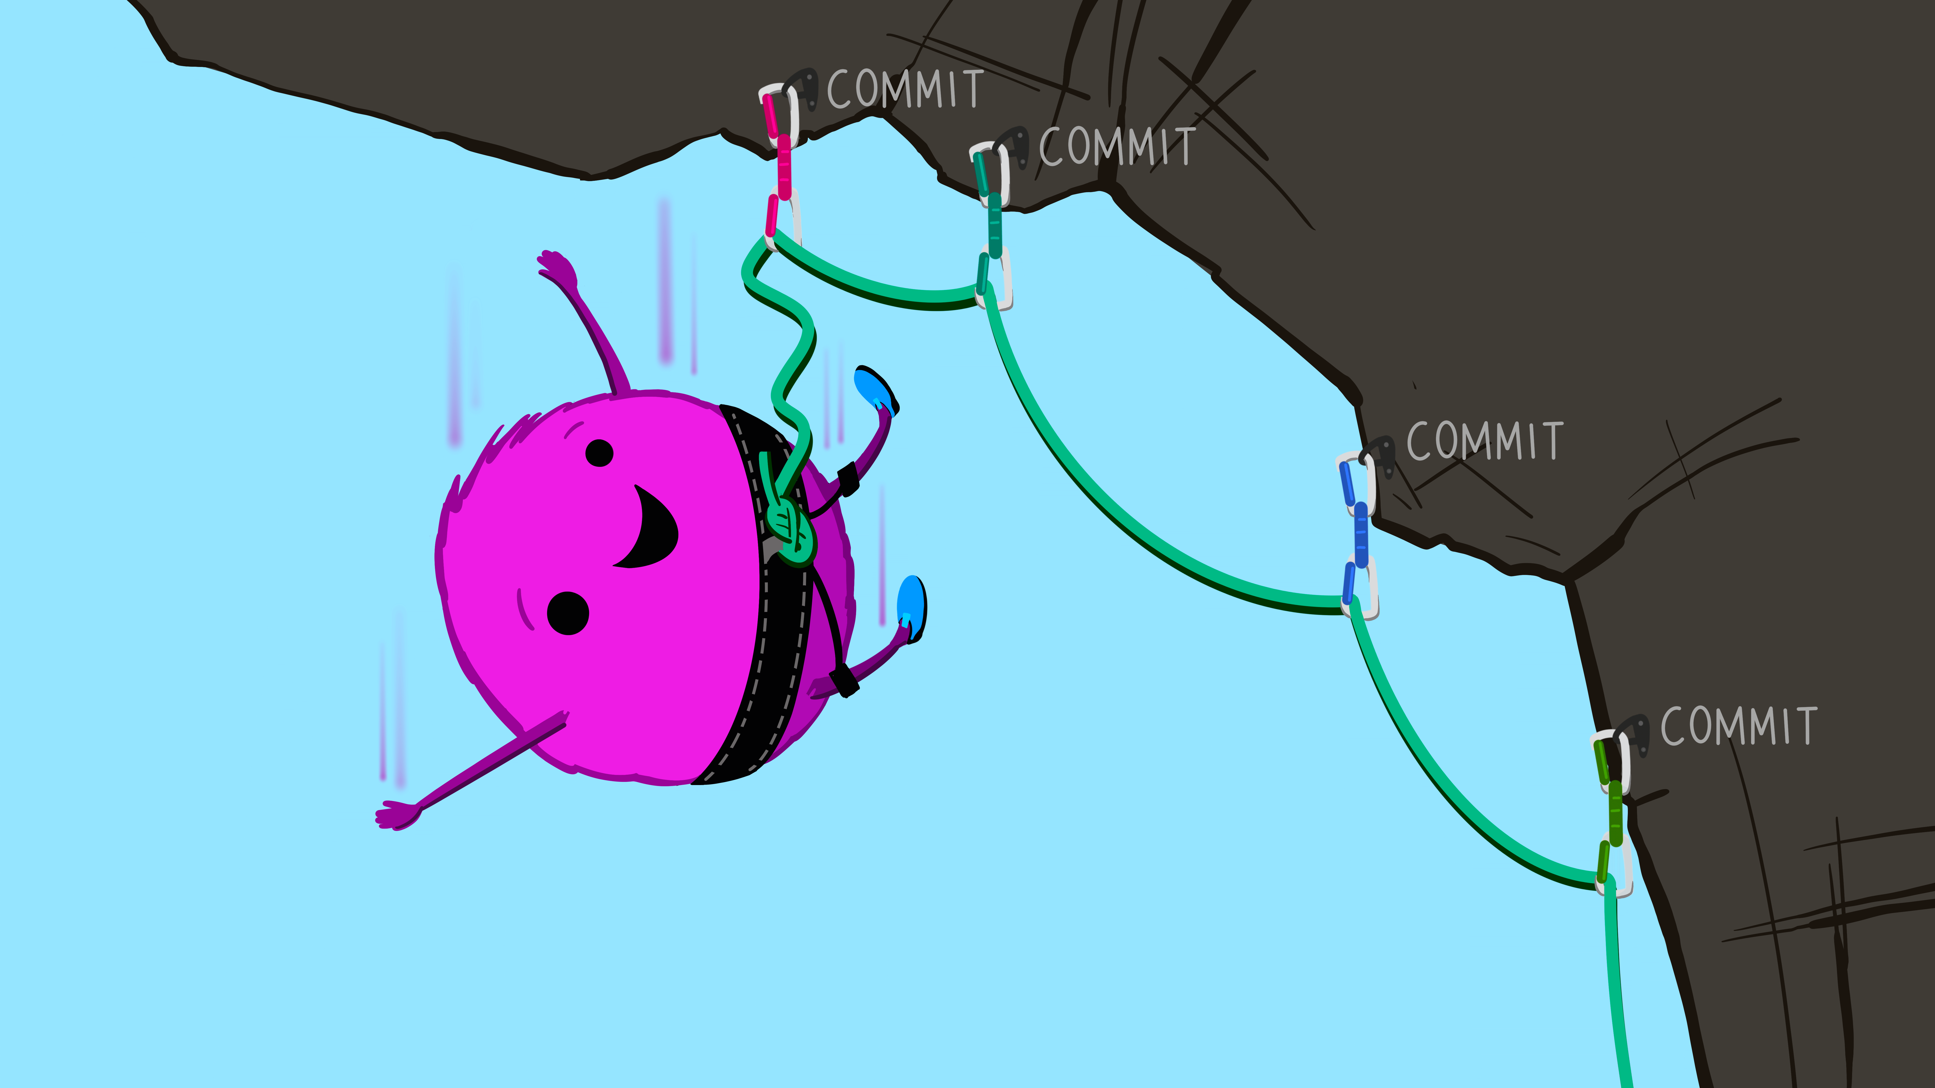
Fail and make mistakes without worrying!
Source: Openscapes.org

Slide 31
Have you created a GitHub account?
It’s free!
Create a username and p/w and login to your GitHub account
https://github.com/

Slide 32
Have you installed git on your system?
https://git-scm.com/downloads
Download and install the appropriate version for your corresponding OS

Slide 33
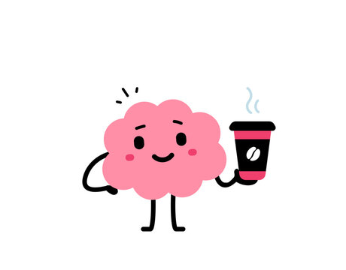
5-minute break

Slide 34
01
What is reproducibility?
02
Data & code reproducibility
Today’s Agenda
03
Git & version control
04
Hands on: GitHub + R

Slide 35
What should I know before I start?
Each project created on GitHub is called a repository
You can also create an organization and have several repositories/projects within
Terms: commit, push, pull, fork…. (can be confusing)

Slide 36
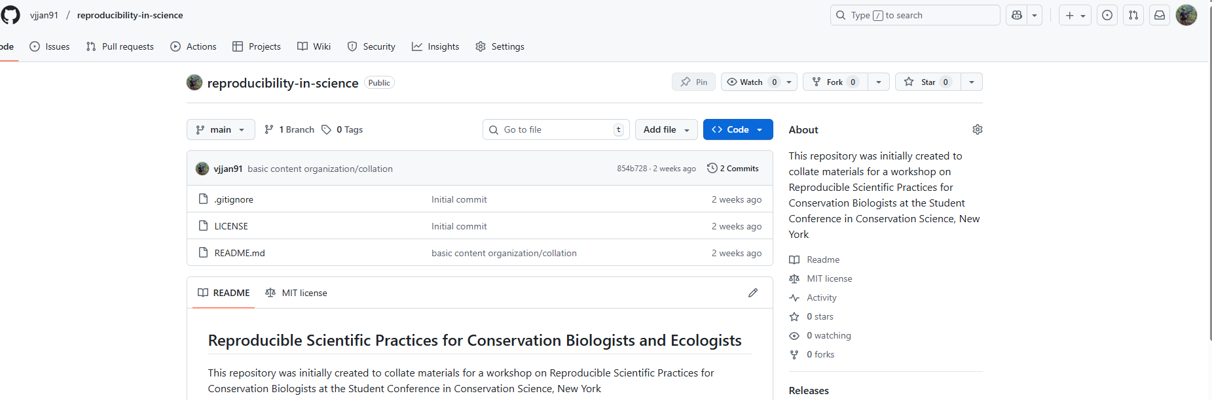
Open this link: https://github.com/vjjan91/reproducibility-in-science
The name of your repository and the account owner
Click here to ‘bookmark’ it

Slide 37
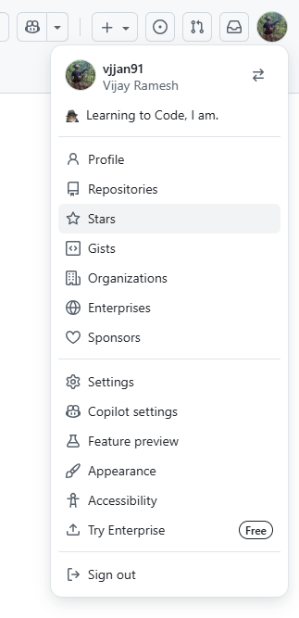
Clicking on your Profile and then Stars should let you access the repositories you have ‘bookmarked’
https://happygitwithr.com/

Slide 38
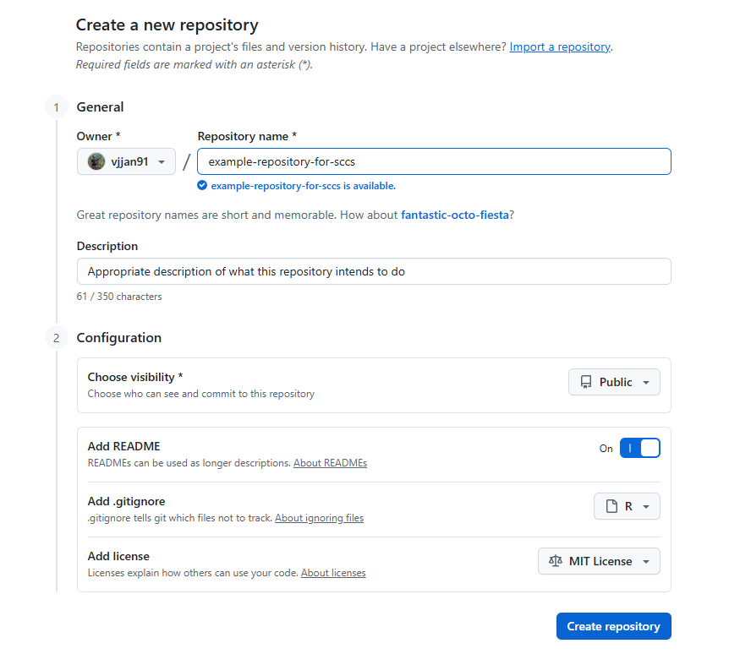
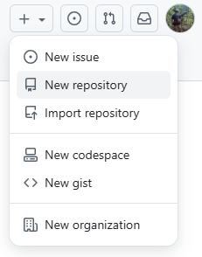
Let’s create a new repository

Slide 39
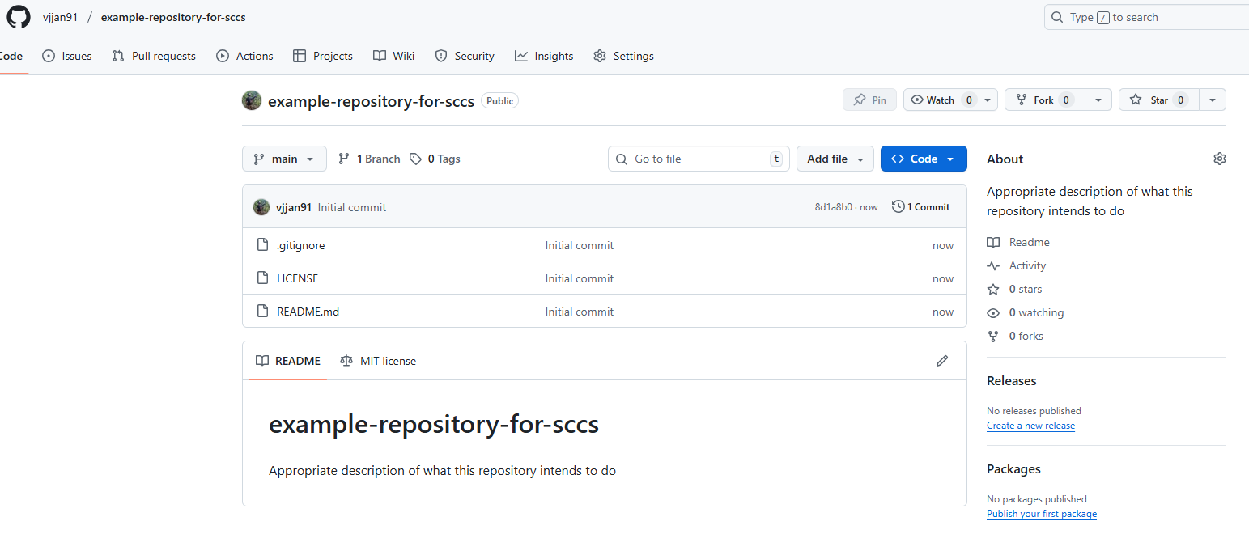
Congrats…you created your first repository!

Slide 40
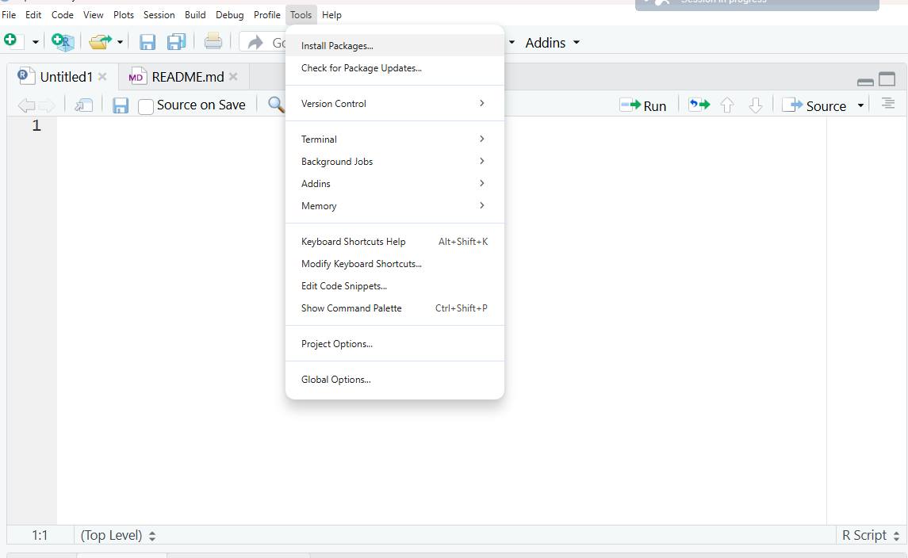
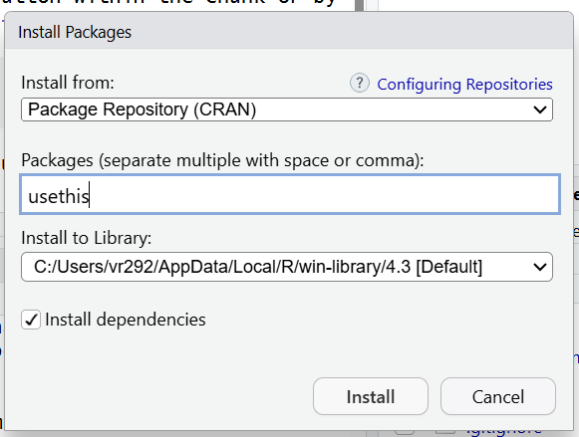
Let’s get GitHub to communicate with RStudio

Slide 41
Personal access token
When we interact with GitHub, we have to include credentials in the request (to provide access to your account)
This proves we are a specific GitHub user, who’s allowed to do whatever we’re asking to do

Slide 42
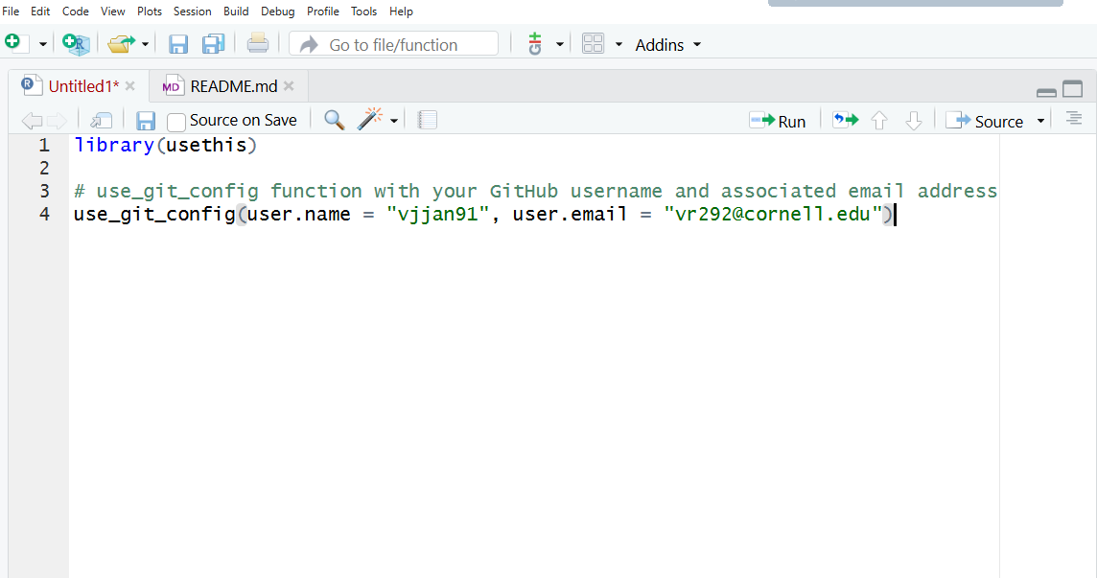
Personal access token

Slide 43
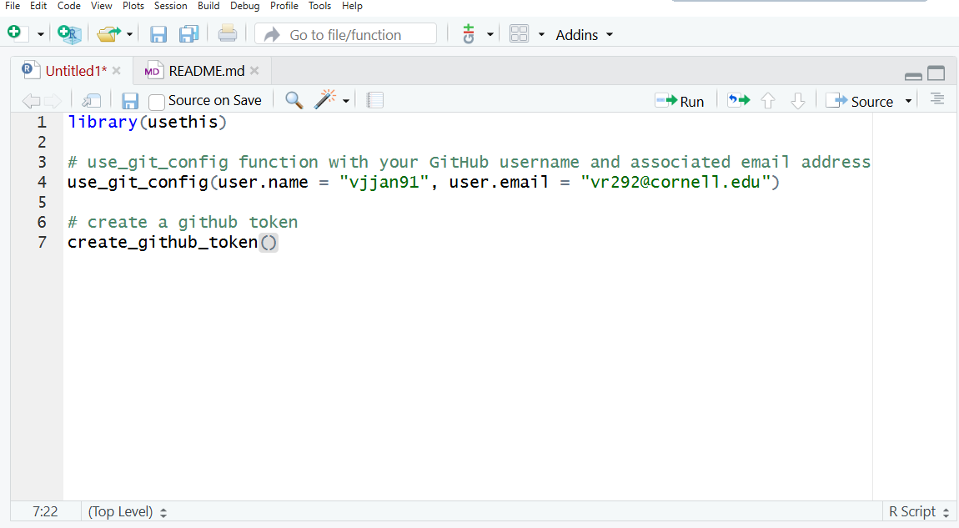
Personal access token
Notes:
Ensure you set a password for your account

Slide 44
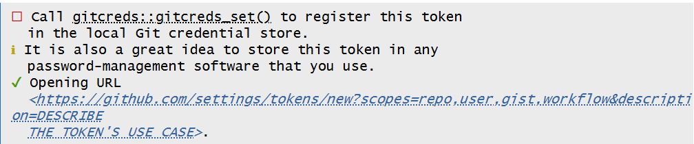
If you ran create_github_token()
It will show you this message in your R Console and open up a new screen in your browser

Slide 45
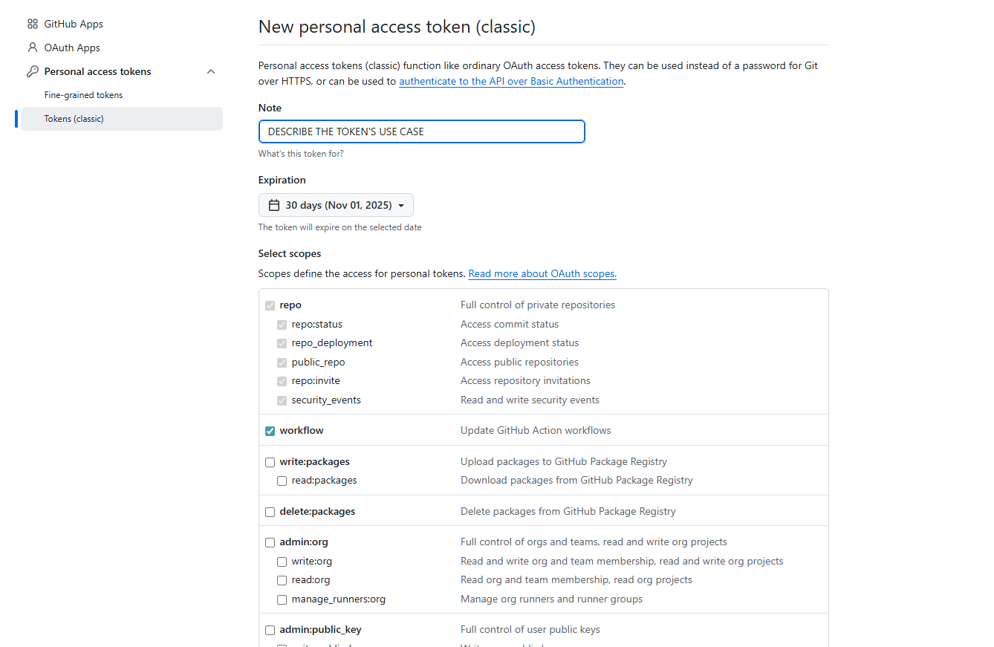

Slide 46
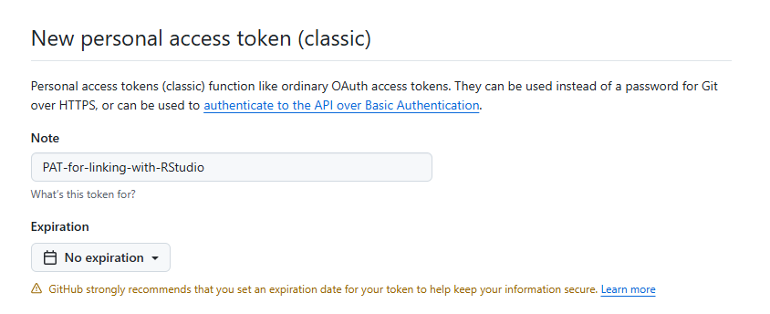
Add an appropriate note

Slide 47
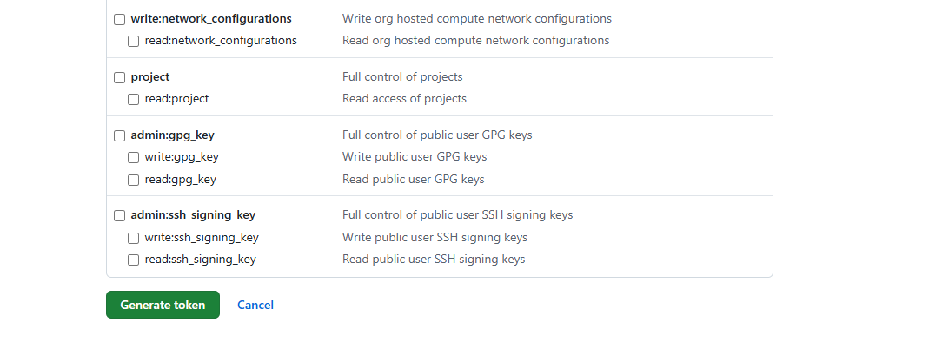

Slide 48
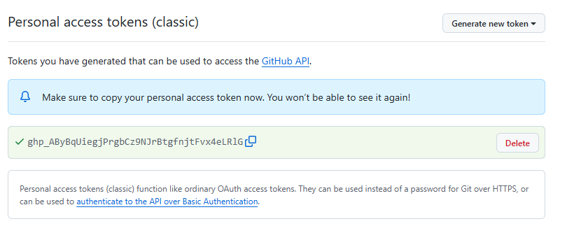
Save it somewhere (like lastpass or a keep note for example)

Slide 49
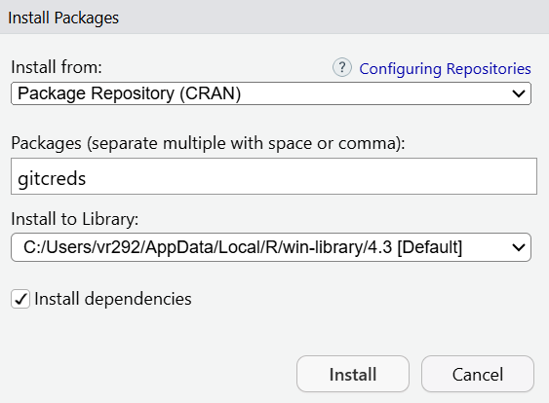
Let’s go back to RStudio and perform a one-time setting to communicate with GitHub

Slide 50
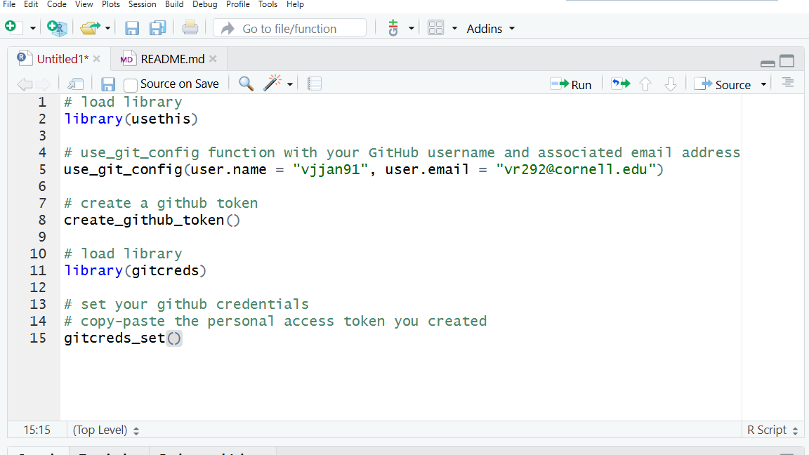
Setting your Git credentials

Slide 51
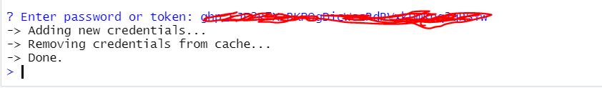
Paste your personal access token when prompted
Your console will prompt you to enter your personal access token

Slide 52
If RStudio did not work for you....we will use terminal!
# display your version of git
git --version
# replace USER with your Github user account
git config --global user.name USER
# replace NAME@EMAIL.EDU with the email you used to register with Github
git config --global user.email NAME@EMAIL.EDU
# list your config to confirm user.* variables set
git config --list

Slide 53
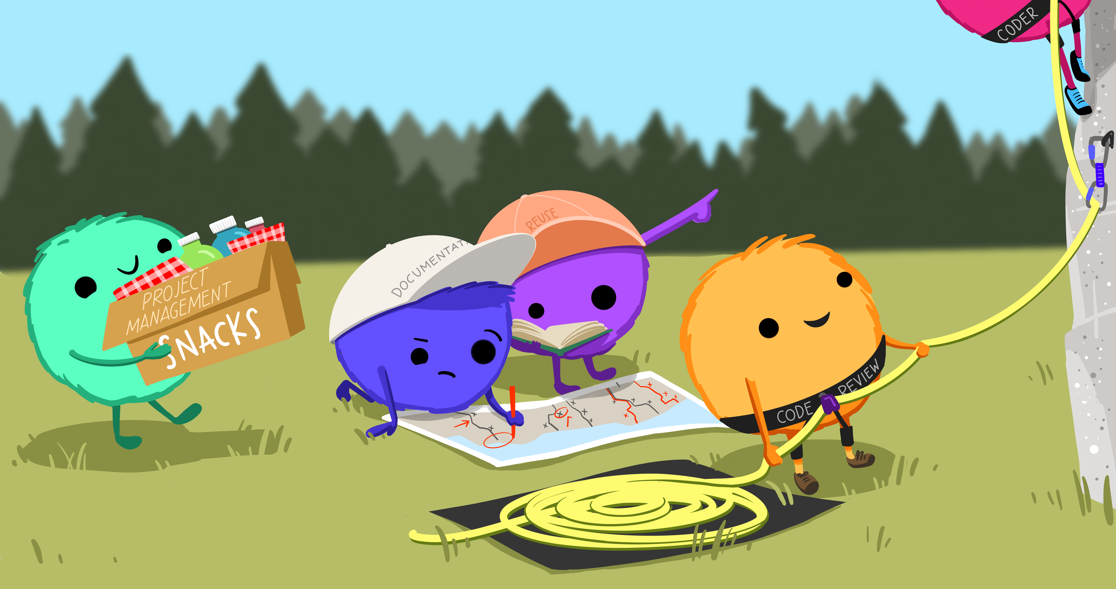
Let’s now harness the power of GitHub
Source: Openscapes.org

Slide 54
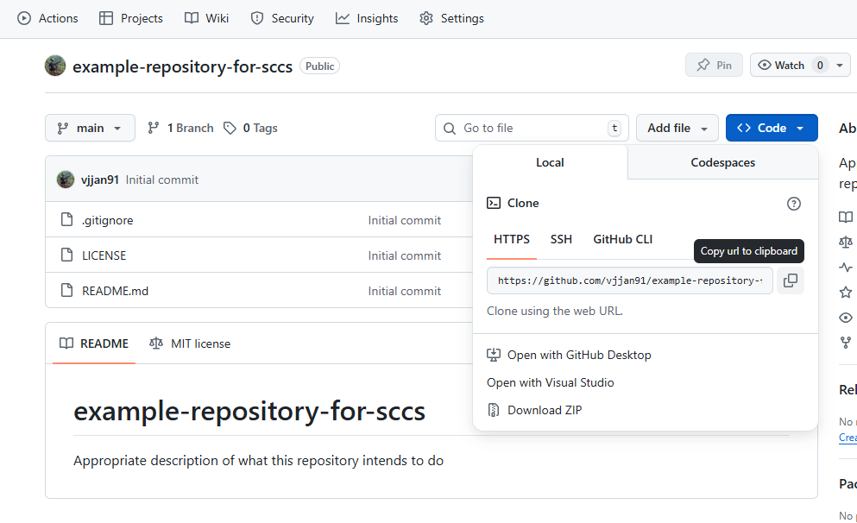
Let’s clone your repository to RStudio

Slide 55
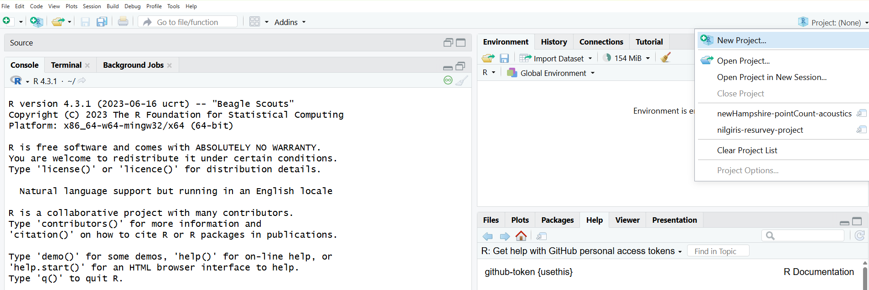
Click New Project

Slide 56
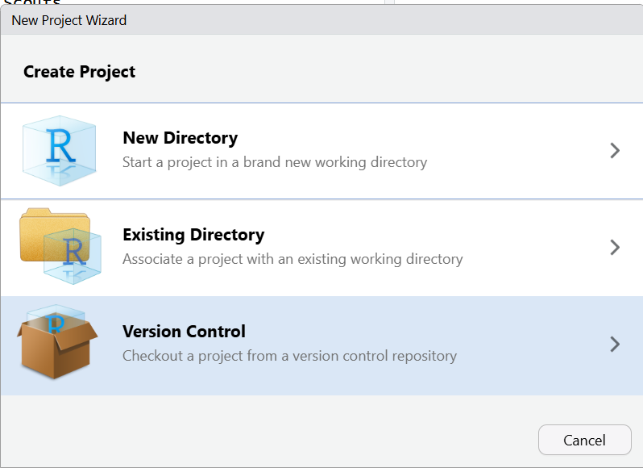
Select version control

Slide 57
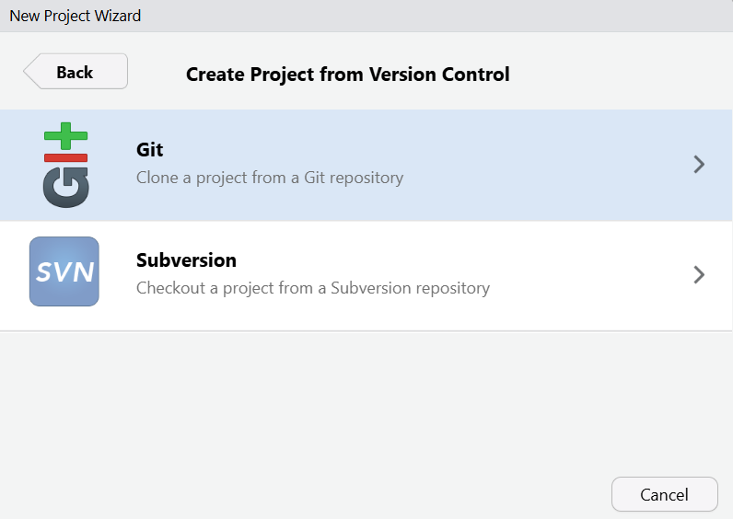
Select Git

Slide 58
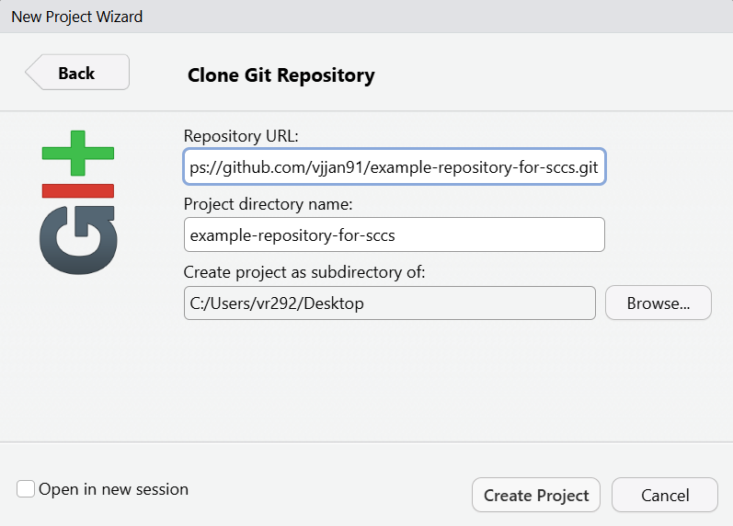
Create project
Same name is ok!
If you want to change directory?

Slide 59
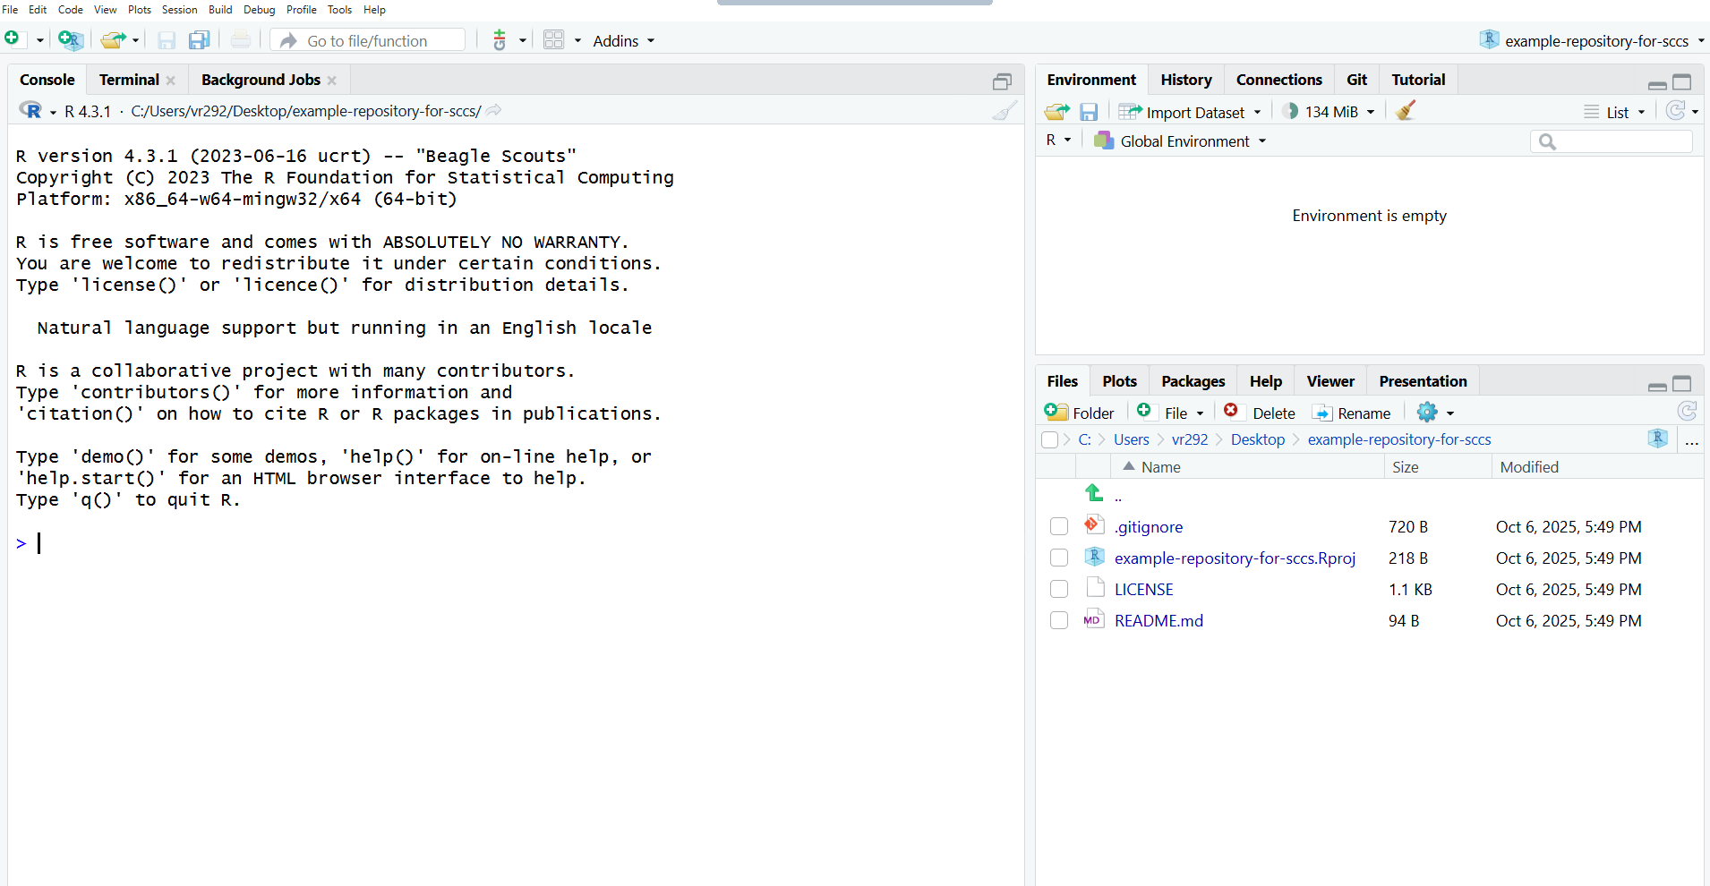
What do we see when we create a new project?
Four files
.gitignore
.Rproj
LICENSE
README.md

Slide 60
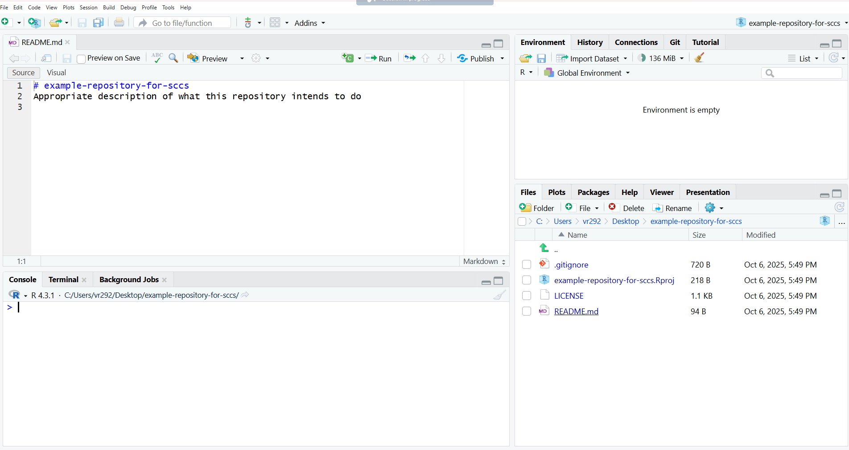
Click your README and edit it

Slide 61
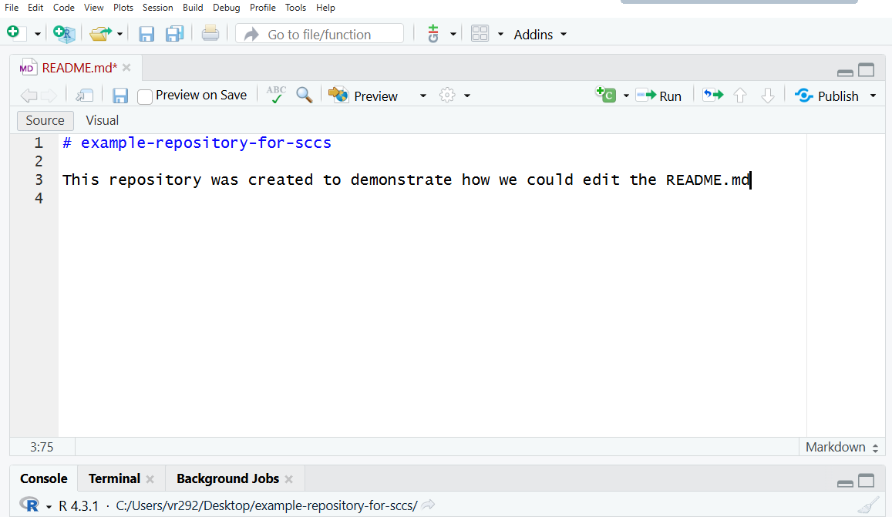
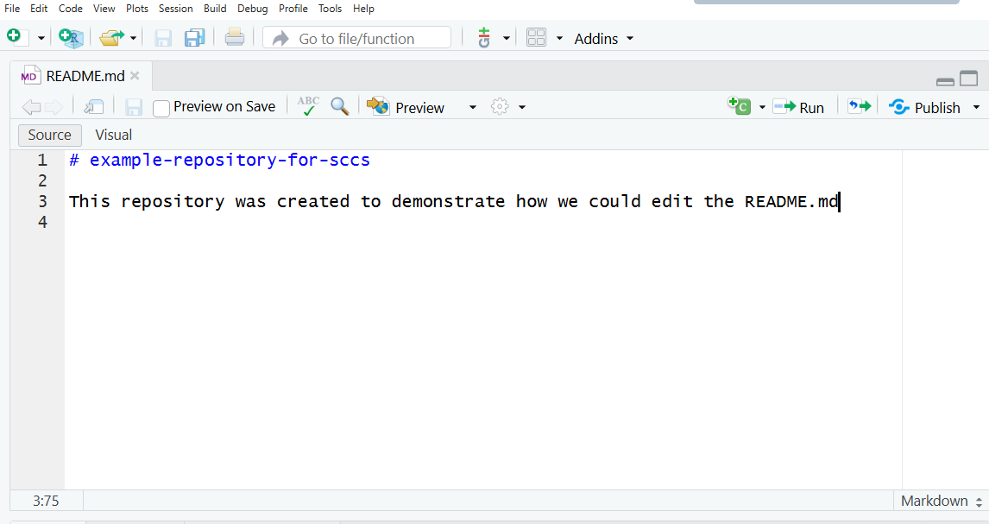
I am going to add some text to my README and save it
Remember to hit the Save button

Slide 62
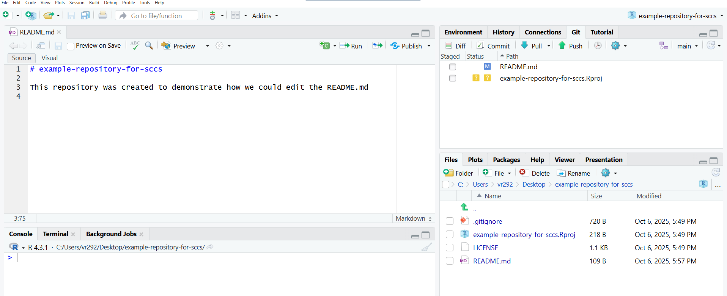
What happens when I save it?

Slide 63

You need to now sync your changes from RStudio (local) to GitHub (remote)

Slide 64
Pull
“Pulling” from the remote repository (github.com) to make sure that our local copy has the most up-to-date information that is available online
We just created the repo…so I am sure there are no changes, but it’s good practice to avoid issues later!
At the beginning of each coding session, always press the blue Pull button

Slide 65


Press the Pull Button

Slide 66

Stage
Staging indicates to GitHub that you will be syncing this file shortly
If you click the box next to the files you want to stage, you are suggesting that you will be syncing these files soon
Always save your file before you start the Stage process

Slide 67

Click this box to Stage

Slide 68
Commit
Saving a snapshot or taking a photograph of your progress (like your cloud backup!)
Very useful if you made errors and need to restore older versions of your work
Can be a single file or multiple files
Two-step process

Slide 69

Why does GitHub use commits?
Source: Openscapes.org

Slide 70
Commit (Step 1): Click the commit button

Slide 71


Commit (Step 2): add text on what you want to commit
Enter a useful message for you to assess what you did later
Click the Commit button after adding text

Slide 72

Commit successful!

Slide 73

Push – the final step!
Sync up with your GitHub repository online
Click the Push button

Slide 74

Push completed!

Slide 75

Congratulations! You synced your changes successfully! Let’s go to github.com and view your repository

Slide 76

BES Guide to Reproducible Code

Slide 77
My go-to series of next steps
If you haven’t already, always stage, commit, and push your .RProj and .gitignore files
Create folder for
/data
/figs
/results
Edit .gitignore to ensure I don’t upload large files (GitHub usually breaks for files over 100MB)

Slide 78
Workshop exercise
Go back to RStudio and repeat the steps we learned for the .Rproj file – this is the R Project File
How do we do this?

Slide 79





Pull → Stage → Commit → Push

Slide 80

Pair up in two’s and explore!

Slide 81

Partner 1 provide collaborator access to Partner 2

Slide 82

Partner 2 (check your email)

Slide 83
Partner 2 - work with Partner 1 to edit the README
What steps does Partner 2 need to take in order to do this?
Clone Partner 1’s repo from GitHub.com and create a New Project in Rstudio

Slide 84
Partner 2: Clone a new project

Slide 85
What are the next series of steps for Partner 2?
Note: Partner 2’s goal is to edit the README and sync it back up with GitHub.com

Slide 86

Partner 2: press the Pull Button

Slide 87
Partner 2: click the README and edit it and remember to save it!

Slide 88



Slide 89
How can Partner 1 view what Partner 2 did?

Slide 90
Questions?

Slide 91
What happens if both Partners edit the same file??
Merge conflict!
When you have collaborators working on the same lines within the same file
GitHub can’t merge the changes automatically
Merge conflicts can be frustrating, but like R’s error messages, they are actually trying to help you
Let’s create a conflict in real-time!

Slide 92
Both Partner 1 and Partner 2 should Pull (note: we are working with Partner 1’s repository)

Slide 93
Create a conflict
Both Partner 1 and Partner 2 edit Line 4 of the README
Please add text independently to the same line 4 without informing your partner about what you will be adding
Remember to save the README

Slide 94
Only Partner 2

Slide 95

Only Partner 1
GitHub is telling me that it knows I’ve modified my README, but since I haven’t staged and committed them, it can’t do its job and merge my conflicts

Slide 96
How do we resolve this for Partner 1?
Stash: Partner 1 can remove the README to a different folder and then Pull, but we don’t want to do this at this time
Let’s follow the suggestion provided in the error message and stage + commit the changes Partner 1 made and Pull again

Slide 97
Only Partner 1
Do not Push!

Slide 98

Only Partner 1
Merge conflict error!

Slide 99

How does Partner 1 solve this?
Go to Terminal and type the following

Slide 100

When Partner 1 makes a Pull, a different error appears

Slide 101

Unresolved conflict in orange for Partner 1
GitHub knows what has changed line-by-line in my file here, and it knows what has changed line-by-line in the version on GitHub.com
And it knows there is a conflict between them. So it’s asking me to now compare these changes, choose a preference, and commit.

Slide 102

Let’s look at the README for Partner 1
Rstudio now shows both edits Partner 1 and Partner 2 made and asks Partner 1 to choose
Partner 1’s changes
Partner 2’s changes

Slide 103

Partner 1 keeps only text they want in the README and saves it

Slide 104

Only Partner 1

Slide 105
Phew….is there an easy solution to this?
Always Pull before you start coding → it’s good practice!
Talk to your collaborator and see the commit history before you work on the same repository
Fork a collaborator’s repository (if time exists, we will cover this)

Slide 106
Fork allows you to safely collaborate!
You are creating your own copy or version of your collaborator’s repository
Source: Openscapes.org

Slide 107

A collaborator can Fork your repository

Slide 108


Slide 109

An example of what that looks like:

Slide 110
You as the collaborator then follow the same procedure
Clone your forked repository and make any changes

Slide 111

After the collaborator makes a push with their changes

Slide 112

Make a pull request to share your changes with Partner 1

Slide 113


Slide 114

Partner 1 (the owner of the repository) can assess if they want to accept changes proposed

Slide 115
01
What is reproducibility?
02
Data & code reproducibility
Today’s Agenda
03
Git & version control
04
Hands on: GitHub + R

Slide 116
Summary
Basics of reproducibility
Adhere to reproducible data organization, storage, and naming conventions for effective collaboration
GitHub + R integration and functionalities
Source: Openscapes.org

Slide 117

A few useful resources
SORTEE (https://sortee.org/other_resources/)
OSF (Open Science Framework)
British Ecological Society
Data Management: https://www.britishecologicalsociety.org/wp-content/uploads/2019/06/BES-Guide-Data-Management-2019.pdf
Reproducible Code: https://www.britishecologicalsociety.org/wp-content/uploads/2017/12/guide-to-reproducible-code.pdf
Jenny Bryan’s https://happygitwithr.com/
Openscapes GitHub for Project Management: https://openscapes.github.io/series/core-lessons/github/github-issues.html
Emilio Bruna’s Data Management class at the University of Florida: https://github.com/BrunaLab/LAS6292_DataManagement
Nina Therkildsen’s Collaborative and Reproducible Data Science course at Cornell University: https://nt246.github.io/NTRES-6100-data-science/

Slide 118
Acknowledgements
SCCS
Nina Therkildsen (Cornell University)
Jenny Bryan (Posit)
Natalie Cooper (Natural History Museum, UK)
Laurel Symes’s Lab (Cornell Lab of Ornithology)

Slide 119

Keystone Foundation - Nilgiris Field Research Center
Questions & Thoughts?
E-mail: vr292@cornell.edu
vjjan91

